Slide 1
Explanatory Modeling
Feature Engineering
PCA
K-Mean Clustering

Slide 2
Feature creation: the first step is to extract more information from raw data
Example: London underground entrance/exit data
Station_ID | Card_ID | Timestamp
481294 | 493068302 | 2018-04-20 20:55:23
… | … | …
From a dataset of 3 columns, there hides a lot of information we can use!
One thing to bear in mind is we need to have a spine before we start building features. In this case, the features built can be joined to the spine.
Second thing to think about is the granularity of dataset. In this case, we need to think of granularity of time. Do we need to aggregate timestamp? If so, what level do we need to aggregate to (e.g., hourly, daily etc.)? If this is not handled carefully, the data can either be too sparse or too aggregated.
Lets brain storm together and think of a list of features we can use:
Lets assume the spine is (station_id, timestamp)
Hourly average flow
Time since last peak hour
…
Station_ID | Timestamp | Average Flow in Past Hour | Time Since Last Peak Hour | … | Feature N
481294 | 2018-04-20 20:55:23 | 36.35 | 542
… | … |  |  |  | …

Slide 3
Feature selection is key to extract the most useful features to consider in the model
Sample features list for previous case:
Lets assume the spine is (station_id, timestamp)
Hourly average flow
Average flow in the past 3 hours
Time since last peak hour
Peak Hour Flag
Number of most frequent traveler of previous day
Average number of travel of previous day
Average journey time in past 3 hours
(300 more features available)
…
Features for Model Input
Final table of features for model input is called master table.
Master table is usually constructed from selected features using feature selection.
The rule of thumb for feature selection is:
Reduces Overfitting: Less redundant data means less opportunity to make decisions based on noise
Improves Accuracy: Less misleading data means modelling accuracy improves
Reduces Training Time: fewer data points reduce algorithm complexity and algorithms train faster

Slide 4
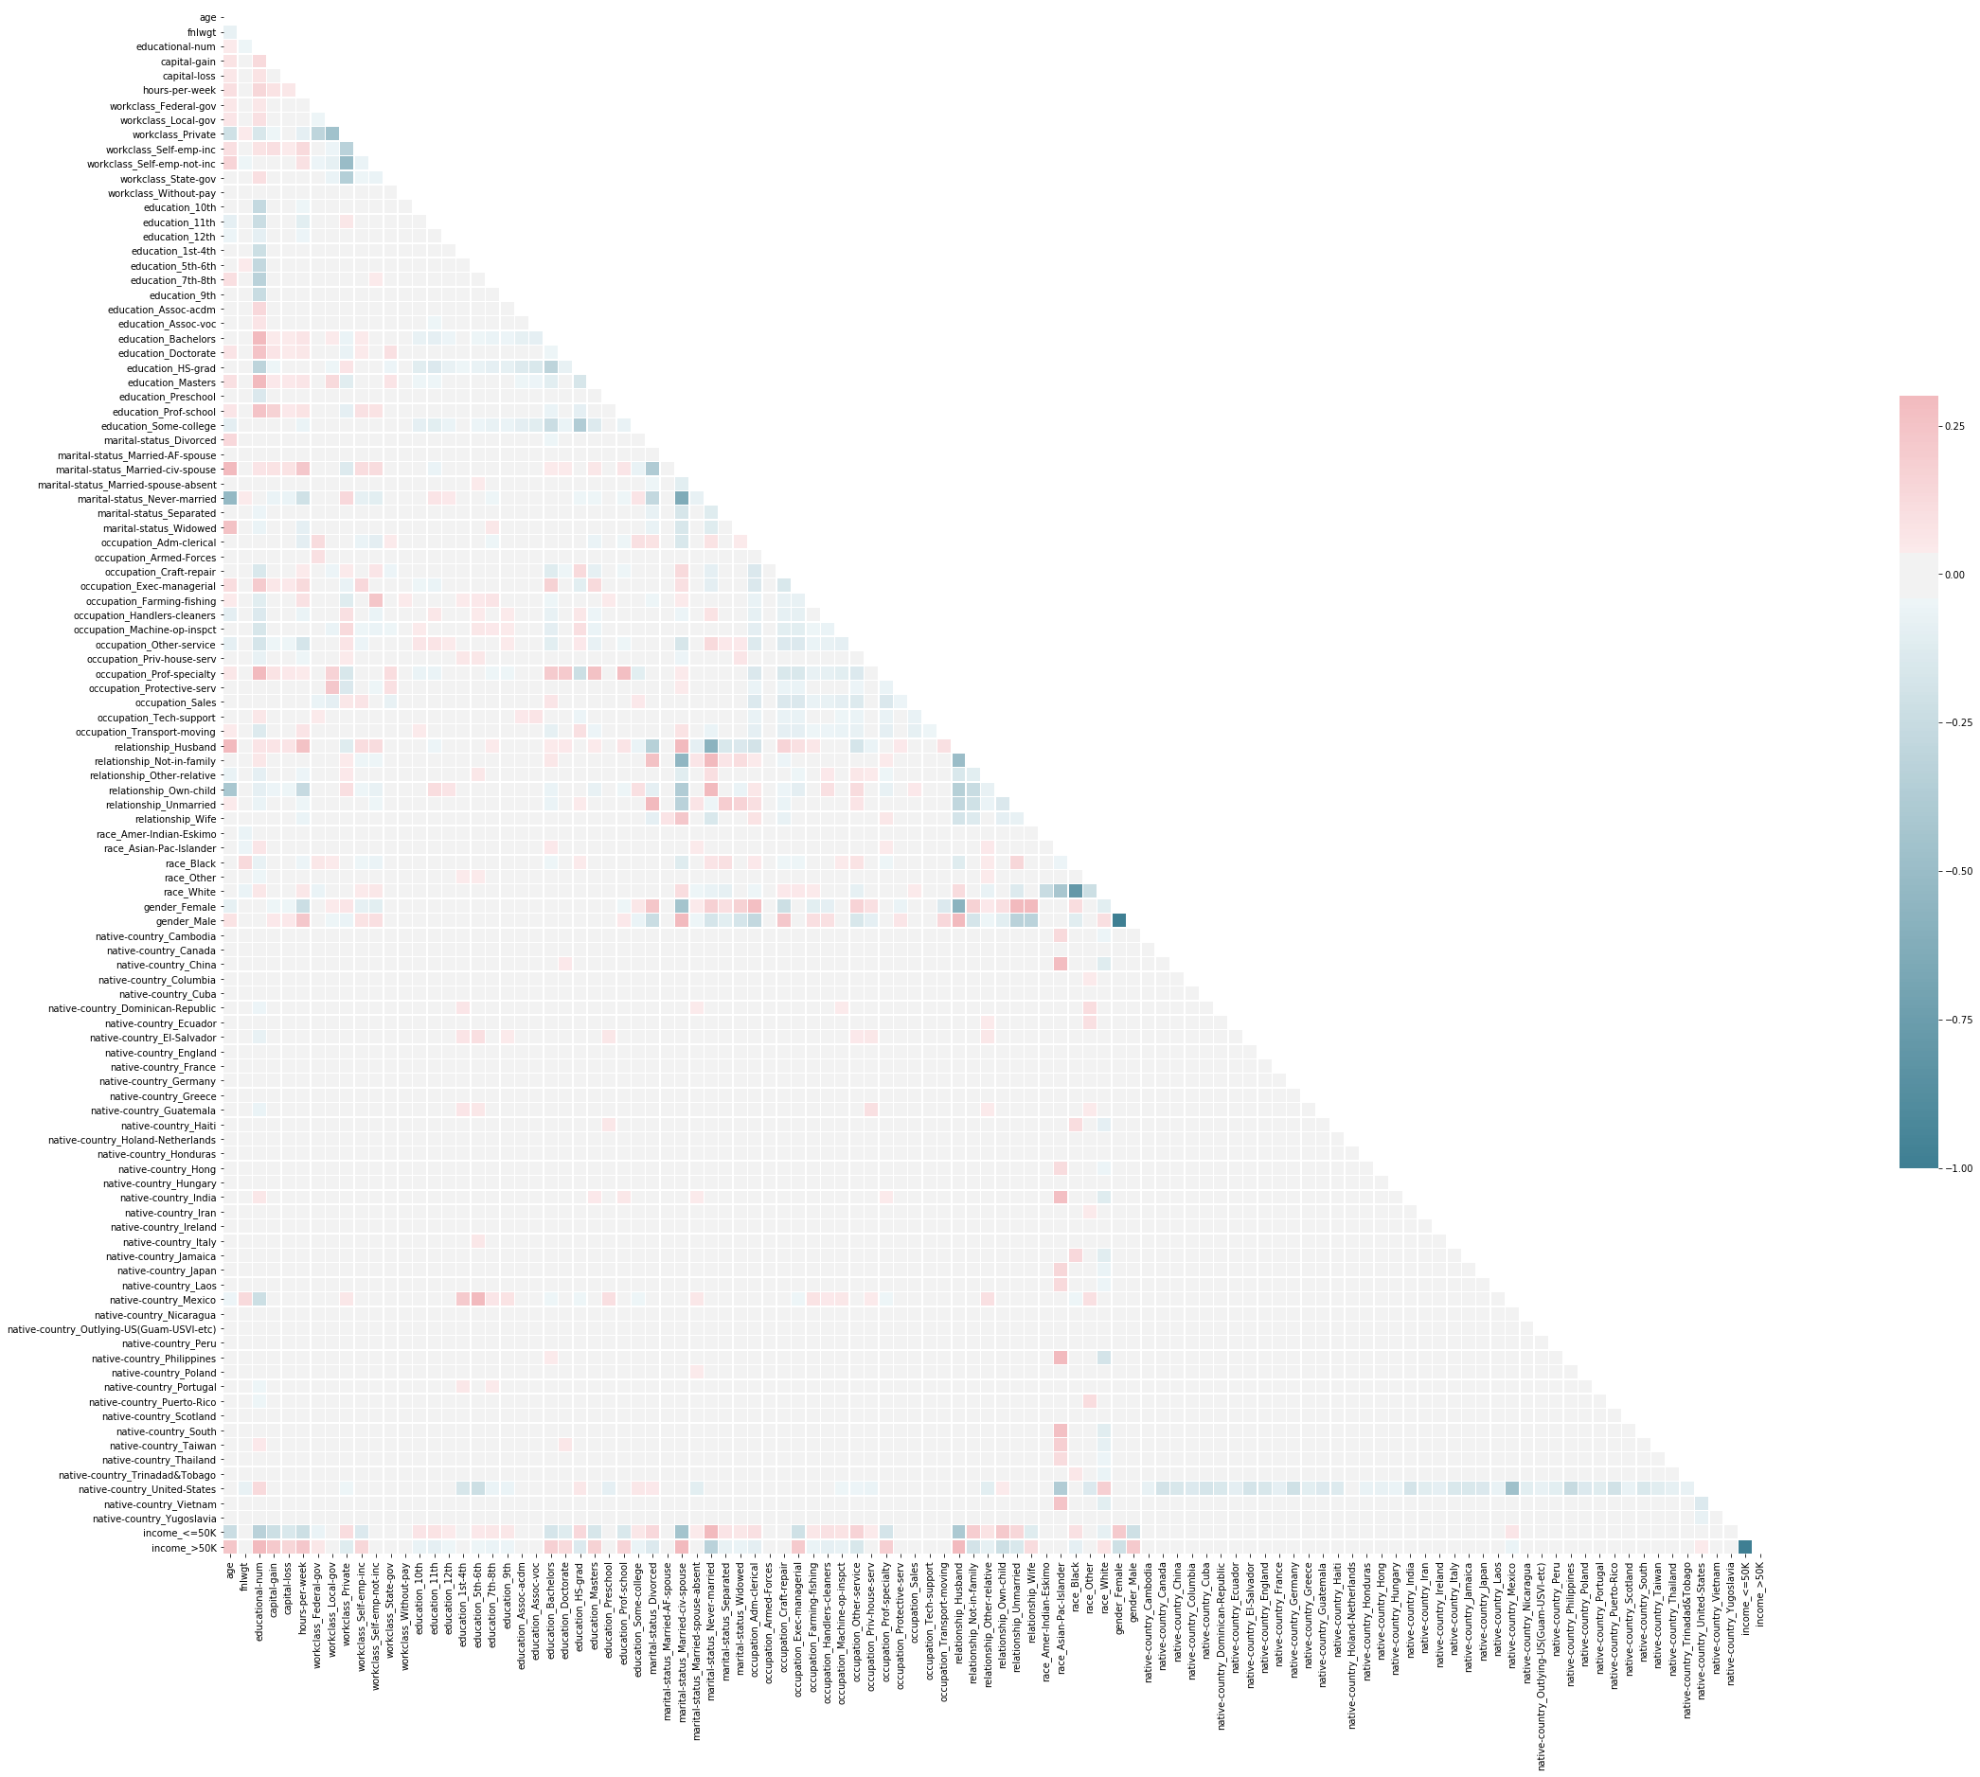
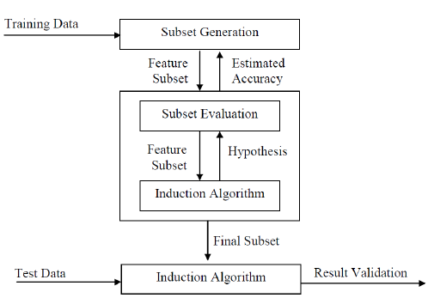
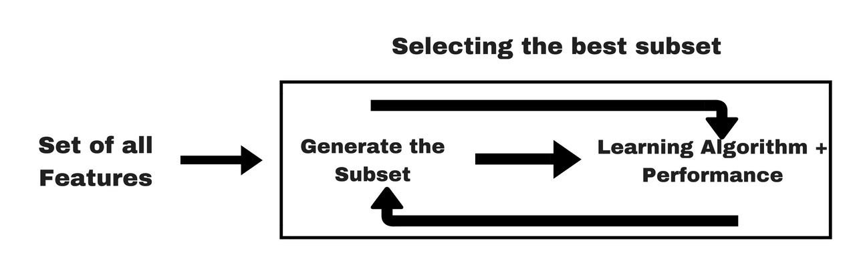
Three main feature selection approaches exist and can be used to address specific feature problem you want to solve
Filter
Wrapping
Embedded
Features are selected on the basis of their scores in various statistical tests for their correlation with the outcome variable (e.g., Pearson’s r)
Wrapper methods use a subset of features and train a model which decides whether to add or remove features based on model performance (e.g., forward selection)
Embedded methods combine the qualities of filter and wrapper methods. They are implemented by algorithms that have their own feature selection methods built-in.

Slide 5
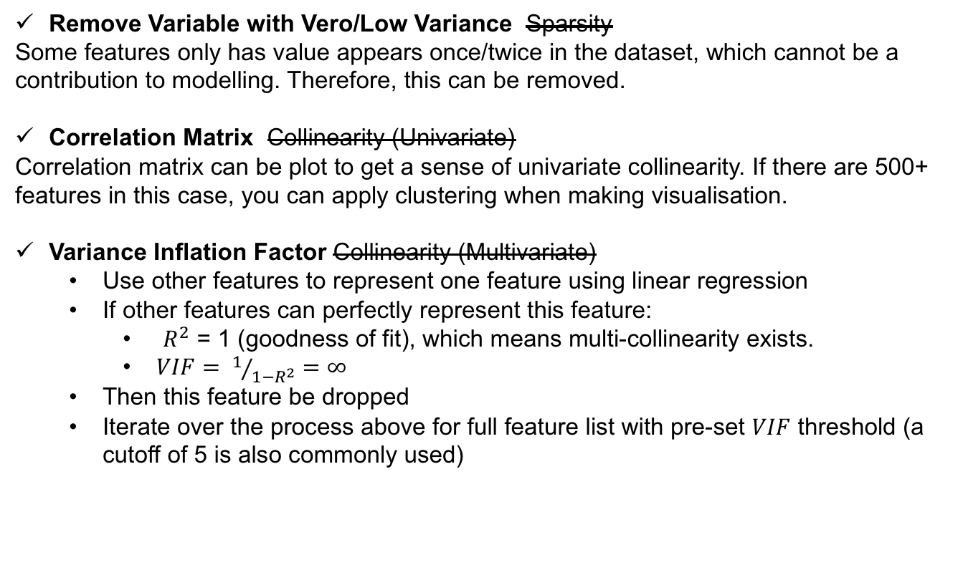
We have a sparse dataset with 500+ features that has high collinearity and multi-collinearity: what would you do to get the master table?
Feature Problem
Feature Selection Solution
500+ Features
Given the large feature list, computation for feature selection must be efficient.
Sparsity
The feature built on some low occurrence flag can be very sparse and not representative in modelling (e.g., a rare rail card flag).
Collinearity
Features built on the same topic can have high collinearity with each other.
Multi-Collinearity
If a feature can be represented by combination of other features, this means multi-collinearity exists
Remove Variable with Vero/Low Variance Sparsity
Some features only has value appears once/twice in the dataset, which cannot be a contribution to modelling. Therefore, this can be removed.
Correlation Matrix Collinearity (Univariate)
Correlation matrix can be plot to get a sense of univariate collinearity. If there are 500+ features in this case, you can apply clustering when making visualisation.
Variance Inflation Factor Collinearity (Multivariate)
Use other features to represent one feature using linear regression
If other features can perfectly represent this feature:
$R^{2}$ = 1 (goodness of fit), which means multi-collinearity exists.
$VIF= 1/{1−R^{2}}=∞$
Then this feature be dropped
Iterate over the process above for full feature list with pre-set $VIF$ threshold (a cutoff of 5 is also commonly used)

Slide 6
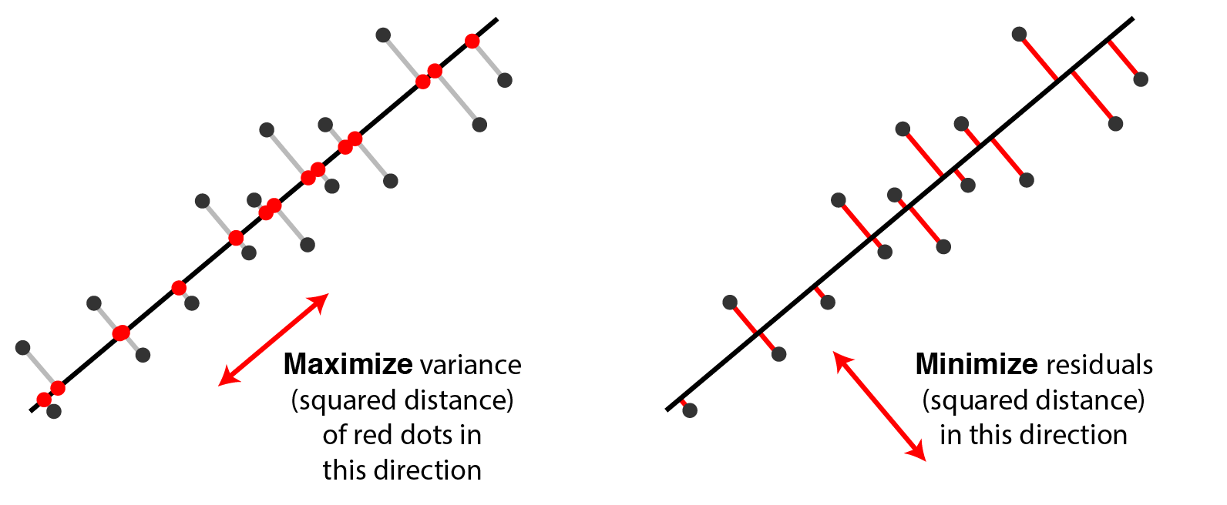

We use Principle Component Analysis (PCA) to reduce dimensionality whilst obtaining most of information within this 150 feature list
Feature 1
180
170
160
Mean(Feature 1)
Let’s first focus on two features: feature 1 and feature 2.
Here, we find the “best fit line” and the mean of each individual axis (point ). Best fit line is defined by maximising variance, not the same as linear regression.
Maximizing variance in principal component space is equivalent to minimizing least-squares reconstruction error
150
140
Mean(Feature 2)
130
10
11
12
13
14
15
16
17
18
Feature 2

Slide 7
The line fitted in PCA is different to ‘Best Fit Line’ in linear regression model. The line in PCA maximises variance whilst minimising residuals
PCA
Linear Regression
Feature 1
Feature 1
180
180
170
170
160
160
150
150
140
140
130
130
10
11
12
13
14
15
16
17
18
10
11
12
13
14
15
16
17
18
Feature 2
Feature 2

Slide 8
… we can construct PC1 based by shifting to the origin. The line fitted is called PC1, and the line perpendicular to that is called PC2.
Feature 1
Feature 1
180
PC2
PC1
170
160
Mean(Feature 1)
Feature 2
150
140
Mean(Feature 2)
130
10
11
12
13
14
15
16
17
18
Feature 2

Slide 9
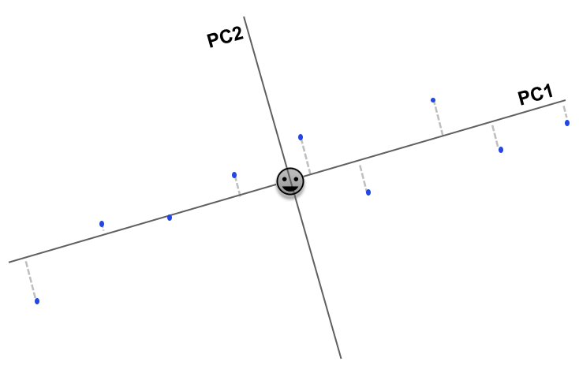
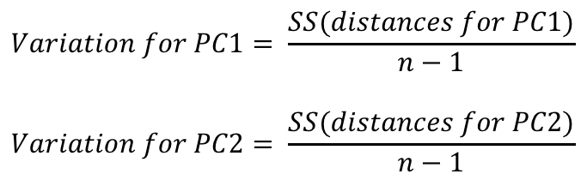
Now, we can ignore the original axis, and rotate PC1 and PC2 to make a brand new plane. Variation for PC can be calculated from sum of squared distance from each data point to plane.
Variation for PC1
Feature 1
Variation for PC2
PC2
PC1
Feature 2
Variation of planes can be calculated using the following equation:
$$Variation for PC1= \frac{SS(distances for PC1)}{n−1}$$
$$Variation for PC2= \frac{SS(distances for PC2)}{n−1}$$

Slide 10
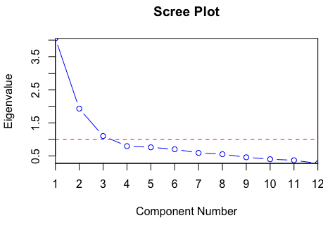
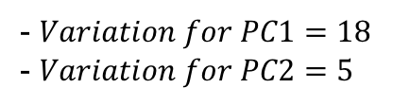
The importance of each PC is equivalent to how much variation that PC accounts for compared with total variation.
Let’s assume
Then the total variation can be calculated using the sum of variations, which is 18 + 5 =23 in this case.
In this case, PC1 accounts for 78% of variation, and PC2 accounts for 22% of variation. Here, a Scree plot can be used to determine the percentage of variation each PC accounts for.
Let’ imagine we have N more features, and we do the above process with PC_{n}, with Scree plot shown on the left.
The cut-off point is the ‘elbow’ point, where PC1, PC2 and PC3 can accounts for most of the data variation
Therefore, data projection on these 3 dimensions is a good approximation to entire dataset.
- $Variation for PC1=18$
- $Variation for PC2=5$
Variation for PC1
Variation for PC2

Slide 11
How k-means clustering works: Begin with random centroids (seeds)
Notes:
Very intuitive
Two dimensions might be wealth vs age (often we use multiple)
Start with hypothesis – assume there are 3 clusters and drop centroids
Assign data points to nearest centroid - Initial imperfect clustering
Move centroids so it’s equidistance from its data points
Ask whether every point is correct colour based on nearest centroid?
Switch labels to cluster with closest centroid
Reassign
Then move centroid to centre of data points again
Repeat

Slide 12
Assign each point to closest centroid

Slide 13
Move centroid to middle of assigned points

Slide 14
Assign each point To closest centroid

Slide 15
Move centroid to middle of assigned points

Slide 16
Assign each point to closest Centroid. No reassignments: STOP

Slide 17

Strengths and challenges of k-means clustering
!
Strengths:
Easy to use and explain
Works well with large data set
Widely applicable to all data types
Can lead to non-obvious insights
Use as an exploratory analysis tool
Challenges:
Difficult to find good clusters, lots of algorithms, no clear winner
Difficult to interpret results
Heavy reliance on distance function
SOURCE: McKinsey Analytics Practice

Slide 18
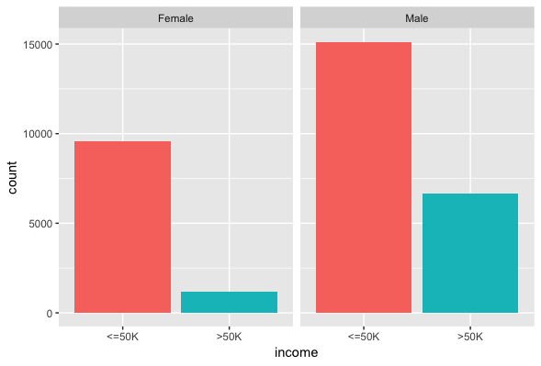
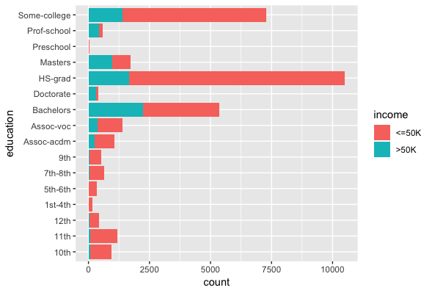
Adult data set
The Adult data set is available from the UCI ML Repository
Data contains personal information like age, education, work class, occupation, marital status, ethnicity
Sensitive attribute gender (male/female) is included
Objective is classification into high salary (>50k) or low salary (<50k).
Train set contains 32,560 observations; test set 16,281.
The data reflects the historical imbalance and bias in salaries with regard to gender but also race and ethnicity.
Dua, D. and Karra Taniskidou, E. (2017). UCI Machine Learning Repository: Irvine, CA: University of California, School of Information and Computer Science.

